Slide 1
More NP-complete Problems

Slide 2
NPC Problems review
SAT is NPC (tableau)
IND SET
3SAT
SAT ≤_{P}
CLIQUE
SAT
IND SET
3SAT
CLIQUE

Slide 3
More NP-complete Problems
3SAT ≤_{P} Vertex-Cover
Vertex-Cover ≤_{P} Cover for triangles
3SAT ≤_{P} 3COL Problem
2SAT ≤_{P} Hamiltonian-Path
2SAT ≤_{P} SUBSET-SUM

Slide 4
Theorem:
(proven in previous class)
If: Language is NP-complete
Language is in NP
is polynomial time reducible to
Then: is NP-complete

Slide 5
How to argue NP-completeness
SUBGRAPH = {〈G, H〉: G and H are graphs where
H is a subgraph of G}
6
7
4
Every edge of H must be included in G
4
5
3
1
2
3
1
2
G
H
SUBGRAPH is NP-complete

Slide 6
How to argue NP-completeness
✔
6
7
4
Step 1: SUBGRAPH is in NP
4
5
3
What is a solution for SUBGRAPH?
1
2
3
1
2
G
H
A solution s is a map from vertices of H to vertices of G
(1➝4)(2➝2)(3➝5)(4➝7)
V :=
On input 〈G, H, s〉
Running time = O(m)
m = number edges in H
For every edge {u, v} of H:
Find u’ and v’ such that u➝u’ and v➝v’ in s.
If {u’, v’} is not an edge in G, reject.
Otherwise, accept.

Slide 7
How to argue NP-completeness
Step 2: Some NP-complete L reduces to SUBGRAPH
Direction of reduction is important!
You want to show SUBGRAPH
is harder than L
VERTEX COVER
So you assume you can solve
SUBGRAPH, and show how
to solve L
IND SET
CLIQUE
SAT
3SAT
This requires converting instances
of L into instances of SUBGRAPH
How to choose L?

Slide 8
Tips on choosing L
6
7
4
4
4
5
3
1
2
3
1
2
G
G
H
CLIQUE（团）
SUBGRAPH
Both CLIQUE and SUBGRAPH are about graph containment, so their complexities may be related
It usually makes sense to try and reduce from the problem that looks the most related（尝试从看起来最相关的问题中减少问题通常是有意义的）

Slide 9
How to argue NP-completeness
✔
Step 3: Reduce CLIQUE to SUBGRAPH
CLIQUE = {〈G, k〉: G has a k-clique}
SUBGRAPH = {〈G, H〉: H is a subgraph of G}
R :=
On input 〈G, k〉
G has a k-clique
Construct the k-clique H
Output 〈G, H〉
H is a subgraph of G

Slide 10
Cover for triangles
A graph has a k-cover for triangles if there are
k vertices that touch all the triangles
(如果有k个顶点接触到所有的三角形，那么一个图对于三角形有k个覆盖)
Does it have a 2-cover for triangles?
Yes
Does it have a 1-cover for triangles?
No, because it has two vertex-disjoint triangles
TRICOVER = {〈G, k〉: G has a k-cover for triangles}
TRICOVER is NP-complete

Slide 11
Cover for triangles
6
7
✔
Step 1: TRICOVER is in NP
5
4
What is a solution for TRICOVER?
1
2
3
A solution s is a subset of vertices like {2,5}
V :=
On input 〈G, k, s〉, where s is a set of vertices of size k
For every triple {u, v, w} of vertices:
If {u, v}, {u, w}, {v, w}, are all edges in G:
If none of u, v, or w are in s, reject.
Otherwise, accept.
Running time = O(n³)

Slide 12
Cover for triangles
Step 2: Some NP-complete L reduces to TRICOVER
TRICOVER = {〈G, k〉: G has a
k-cover for triangles}
SUBGRAPH
VERTEX COVER
Some vertex in every triangle is covered
IND SET
CLIQUE
SAT
VC = {〈G, k〉: G has a k-vertex cover}
3SAT
Some endpoint of every edge is covered

Slide 13
Cover for triangles
Step 3: Reduce VC to TRICOVER
VC = {〈G, k〉: G has a k-vertex cover (for edges)}
TRICOVER = {〈G’, k’〉: G’ has k’-cover for triangles}
Idea: Replace edges by triangles
G
G’
vertex-cover in G
cover for triangles in G’

Slide 14
Cover for triangles
Step 3: Reduce VC to TRICOVER
R :=
On input 〈G, k〉, where G has n vertices and m edges
Construct the following graph G’:
G’ has n + m vertices v₁, ..., v_{n},
and u_{ij} for every edge {v_{i}, v_{j}} of G
For every edge {v_{i}, v_{j}} of G,
include the edges {v_{i}, v_{j}}, {v_{i}, u_{ij}}, {v_{j}, u_{ij}} in G’
Output 〈G’, k〉.
Running time = O(m)
m = number of edges in G

Slide 15
Cover for triangles
Step 4: Argue that the reduction is correct
〈G, k〉 ∈ VC
〈G’, k〉 ∈ TRICOVER
G
✔
G’
G has a k-vertex cover C
C is a k-triangle cover of G’
Old triangles from G are covered
New triangles in G’ also covered

Slide 16
Cover for triangles
Step 4: Argue that the reduction is correct
✔
〈G, k〉 ∈ VC
〈G’, k〉 ∈ TRICOVER
G
✔
G’
G has a k-vertex cover C’
G’ has a k-vertex cover C
C’ is obtained after moving some
vertices of C
Some vertices in C may not
come from G!
Since C’ covers all triangles in G’,
it must cover all edges in G
But we can move them and still
cover the same triangle

Slide 17
Vertex Cover
Vertex cover of a graph
is a subset of nodes such that every edge
in the graph touches one node in
Example:
S = red nodes

Slide 18
Size of vertex-cover
is the number of nodes in the cover
Example:
|S|=4

Slide 19
Corresponding language:
VERTEX-COVER = { :
graph contains a vertex cover
of size }
Example:

Slide 20
Theorem:
VERTEX-COVER is NP-complete
Proof:
1. VERTEX-COVER is in NP
Can be easily proven
2. We will reduce in polynomial time
3CNF-SAT to VERTEX-COVER
(NP-complete)

Slide 21
Let be a 3CNF（合取范式） formula
with variables
and clauses
Example:
Clause 1
Clause 2
Clause 3

Slide 22
Formula can be converted
to a graph such that:
is satisfied
if and only if
Contains a vertex cover
of size

Slide 23
Clause 1
Clause 2
Clause 3
Variable Gadgets
nodes
Clause Gadgets
nodes
Clause 1
Clause 2
Clause 3

Slide 24
Clause 1
Clause 2
Clause 3
Clause 1
Clause 2
Clause 3

Slide 25
First direction in proof:
If is satisfied,
then contains a vertex cover of size

Slide 26
Example:
Satisfying assignment
We will show that contains
a vertex cover of size

Slide 27
Put every satisfying literal in the cover

Slide 28
Select one satisfying literal in each clause gadget
and include the remaining literals in the cover

Slide 29
This is a vertex cover since every edge is
adjacent to a chosen node

Slide 30
Explanation for general case:
Edges in variable gadgets
are incident to at least one node in cover

Slide 31
Edges in clause gadgets
are incident to at least one node in cover,
since two nodes are chosen in a clause gadget

Slide 32
Every edge connecting variable gadgets
and clause gadgets is one of three types:
Type 1
Type 2
Type 3
All adjacent to nodes in cover

Slide 33
Second direction of proof:
If graph contains a vertex-cover
of size
then formula is satisfiable

Slide 34
Example:

Slide 35
To include “internal’’ edges to gadgets,
and satisfy
exactly one literal in each variable gadget is chosen
chosen out of
exactly two nodes in each clause gadget is chosen
chosen out of

Slide 36
For the variable assignment choose the
literals in the cover from variable gadgets

Slide 37
is satisfied with
since the respective literals satisfy the clauses

Slide 38
Coloring
Suppose you need to schedule
exams on same day in 3 time slots
CSCI 3230
CSCI 3190
Y
R
B
CSCI 2110
10³⁰-12³⁰
1³⁰-3³⁰
4³⁰-6³⁰
CSCI 3130
CSCI 3160
Some people are enrolled in
multiple classes, so there may be conflicts
Task: Schedule the exams so there are no conflicts

Slide 39
Coloring
Given a graph, we want to color
the vertices so every edge has
endpoints of different colors
G
Y
R
B
This is called a valid 3-coloring
3COL = {〈G〉: G has a valid 3-coloring}
3COL is NP-complete

Slide 40
Coloring
✔
5
Step 1: 3COL is in NP
4
3
G
What is a solution for 3COL?
1
2
A solution s is a coloring of vertices like
{1B,2R,3Y,4R,5B}
V :=
On input 〈G, s〉
Running time = O(m)
For every edge {u, v} of G:
If u and v are assigned same color in s, reject.
Otherwise, accept.

Slide 41
Coloring
Step 2: Some NP-complete L reduces to 3COL
3COL = {〈G〉: G has a valid 3-coloring}
SUBGRAPH
3COL does not look like
any of these problems
VERTEX COVER
CLIQUE
IND SET
In such a case it is a good
idea to start with 3SAT
SAT
3SAT

Slide 42
Coloring
Step 3: Reduce 3SAT to 3COL
3SAT = {〈φ〉: φ is a 3CNF that has a satisfying assignment}
3COL = {〈G〉: G has a valid 3-coloring}
Idea: Assignment of φ
Coloring of G
X
G
T
F
Part I: 3 special vertices T (true), F (false), and X

Slide 43
Coloring
Either x_{i} has color of T
and x_{i} has color of F
X
x_{i}
x_{i}
Or x_{i} has color of F
and x_{i} has color of T
Part 2: For each variable x_{i}
T
F
F
T
F
T
x₁
x₁
x₂
x₂
x₃
x₃
X
T
F
Example:
(x₁∨x₁∨x₂)∧(x₁∨x₂∨x₃ )

Slide 44
Coloring
To “encode” the clauses of φ, we need a gadget
x
If x or y is colored T, z can be colored T
z
y
If x and y are colored F, z must be colored F
x₁
Can be colored if and only if
at least one literal is colored T
x₂
T
x₃
Part 3: For each clause like (x₁∨x₂∨x₃ )

Slide 45
Coloring reduction: An example
x₁
x₁
x₂
x₂
x₃
x₃
X
T
F
Example:
(x₁∨x₁∨x₂)∧(x₁∨x₂∨x₃ )
T
F
F
T
F
T

Slide 46
Coloring reduction: An example
x₁
x₁
x₂
x₂
x₃
x₃
X
T
F
Example:
(x₁∨x₁∨x₂)∧(x₁∨x₂∨x₃ )
T
F
F
T
F
T

Slide 47
Coloring
Step 3: Reduce 3SAT to 3COL
Running time = O(m + n)
n = number of variables
m = number of clauses
R :=
On input 〈φ〉, where φ is a 3CNF:
Construct the following graph G:
Add 3 special vertices T, F, X connected by a triangle.
For every variable x_{i} of φ, add vertices x_{i} and x_{i}
and include the triangle x_{i}, x_{i}, X.
For every clause u∨v∨w of φ, connect u, v, w, and T
using the gadget below.
u
Output 〈G〉.
v
T
w

Slide 48
Coloring
Step 4: Argue that the reduction is correct
〈φ〉 ∈ 3SAT
〈G〉 ∈ 3COL
✔
(x₁∨x₁∨x₂)∧(x₁∨x₂∨x₃ )
x₁
x₁
x₂
x₂
x₃
x₃
X
T
F
φ has a SAT assignment a
G has a valid 3-coloring
Each literal gets “color” as in a
Each clause gadget contains a
true literal, so it can be colored

Slide 49
Coloring
Step 4: Argue that the reduction is correct
〈φ〉 ∈ 3SAT
〈G〉 ∈ 3COL
✔
(x₁∨x₁∨x₂)∧(x₁∨x₂∨x₃ )
x₁
x₁
x₂
x₂
x₃
x₃
φ has a SAT assignment
X
G has a valid 3-coloring c
T
F
Each variable gets value as in G
true, if node x_{i} has same color as T
x_{i} =
false, if node x_{i} has same color as F
Since each clause gadget is colored properly,
each clause must contain a true literal

Slide 50
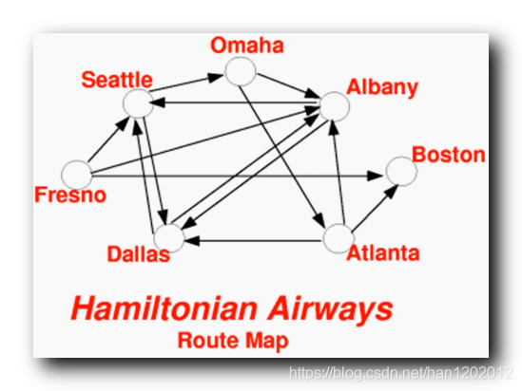
HAMILTONIAN-PATH
HAMILTONIAN-PA也称作哈密顿链，如下图所示，从某个顶点出发 , 将所有的顶点都走一遍, 并且每个顶点只能经过一次，经过所有顶点的圈称为哈密顿圈 ，经过所有顶点的道路称为哈密顿道路 , 又称为哈密顿路径
简单概括为：在图G中找出一条包含所有顶点的简单路径，该路径称为哈密顿路径。

Slide 51
Theorem:
HAMILTONIAN-PATH
is NP-complete
Proof:
1. HAMILTONIAN-PATH is in NP
Can be easily proven
2. We will reduce in polynomial time
2CNF-SAT to HAMILTONIAN-PATH
(NP-complete)

Slide 52
Gadget for
variable
Number of nodes in row:
for clauses

Slide 53
clause node
Gadget for
variable
clause node
pair 1
pair 2
A pair of nodes in gadget for each clause node;
Pairs separated by a node

Slide 54
clause node
Gadget for
variable
outgoing
incoming
pair 1
If variable appears as is in clause:
first edge from gadget outgoing (left to right)
second edge from gadget incoming

Slide 55
Gadget for
variable
the directions change
clause node
pair 2
outgoing
incoming
If variable appears inverted in clause:
first edge from gadget incoming (left to right)
second edge from gadget outgoing

Slide 56
clause node
Gadget for
variable
clause node
pair 1
pair 2

Slide 57
clause node
Gadget for
variable
clause node
pair 1
pair 2

Slide 58
Complete Graph

Slide 59
Satisfying assignment:
Satisfying assignment:

Slide 60
Hamiltonian
path
Gadget for
If variable is set to 1 traverse its gadget
from left to right
Visit clauses satisfied from the variable assignment

Slide 61
Hamiltonian
path
Gadget for
If variable is set to 0 traverse its gadget
from right to left
Visit clauses satisfied from the variable assignment

Slide 62
A satisfying
assignment
Hamiltonian
path

Slide 63
Another satisfying
assignment
Hamiltonian
path

Slide 64
For each clause pick one variable that
satisfies it and visit respective node once
from that variable gadget

Slide 65
Symmetrically, it can also be shown:
if the graph has a Hamiltonian path,
then the formula has a satisfying assignment
Basic idea:
Each clause node is visited exactly once
from some variable gadget, and that variable
satisfies the clause

Slide 66
It is impossible a clause node to be traversed
from different variable gadgets
Node not visited
Node repeated

Slide 67
Therefore:
The formula is satisfied if and only if
the respective graph has a Hamiltonian path

Slide 68
The proof can apply to any 3CNF formula
The graph is constructed in polynomial
time with respect to the size of the formula
Therefore:
we have reduced in polynomial time
3CNF-SAT to HAMILTONIAN-PATH
End of proof

Slide 69
Theorem:
UHAMPATH
is NP-complete
(undirected version of the Hamiltonian path problem)
Proof:
1. HAMILTONIAN-PATH is in NPC
Proven above
2. We will reduce in polynomial time
HAMILTONIAN-PATH to UHAMPATH
(NP-complete)

Slide 70
u
u
v
Gadget for
variable
v
u_{mid}
u_{in}
u_{mid}
u_{out}
u_{in}
u_{out}
v_{mid}
v_{in}
v_{mid}
v_{out}
v_{in}
v_{out}
s
s_{out}
t
t_{in}

Slide 71
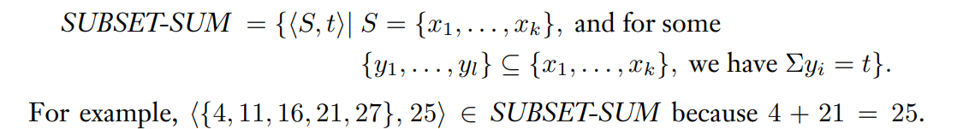
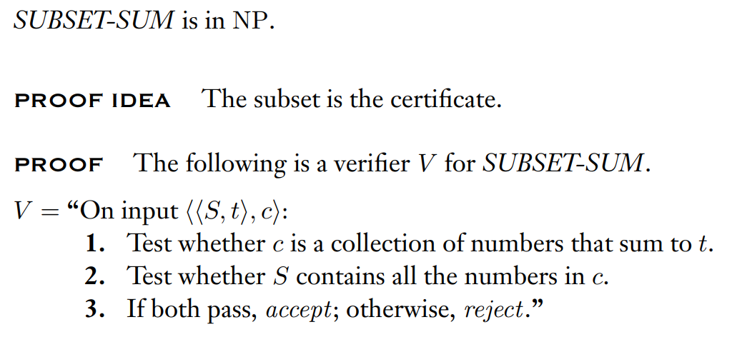
SUBSET-SUM

Slide 72
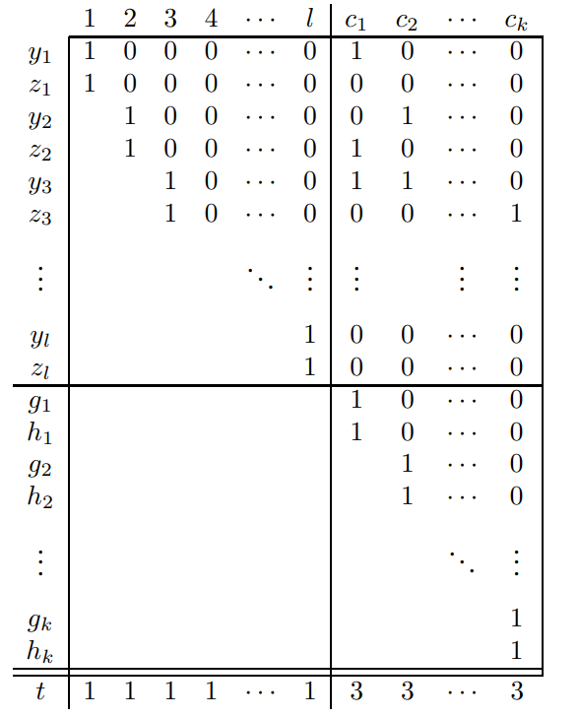
Clause gadgets
3SAT ≤_{P} SUBSET-SUM
3cnf φ
variables: x1,...,xl
clauses: c1,...,ck
SUBSET-SUM
⟨S, t⟩
S={Y,Z,G,H}
x_{i}
y_{i}
,z_{i}
Variable gadgets
to
y_{i} in column c_{j} is 1 if clause c_{j} contains literal x_{i}
z_{i} in column c_{j} is 1 if clause c_{j} contains literal x_{i}

Slide 73
is satisfied with
 | 1 | 2 | c1 | c2
y1 | 1 | 0 | 1 | 0
z1 | 1 | 0 | 0 | 1
y2 |  | 1 | 1 | 1
z2 |  | 1 | 0 | 0
g1 |  |  | 1 | 0
h1 |  |  | 1 | 0
g2 |  |  |  | 1
h2 |  |  |  | 1
t | 1 | 1 | 3 | 3
⟨S, t⟩
t=1133
S={1010,1001,111,100,10,10,1,1}

Slide 74
is satisfied with
 | 1 | 2 | c1 | c2
y1 | 1 | 0 | 1 | 0
z1 | 1 | 0 | 0 | 1
y2 |  | 1 | 1 | 1
z2 |  | 1 | 0 | 0
g1 |  |  | 1 | 0
h1 |  |  | 1 | 0
g2 |  |  |  | 1
h2 |  |  |  | 1
t | 1 | 1 | 3 | 3
2SAT -> SUBSET SUM
⟨S, t⟩
t=1133
S={1010,1001,111,100,10,10,1,1}

Slide 75
is satisfied with
 | 1 | 2 | c1 | c2
y1 | 1 | 0 | 1 | 0
z1 | 1 | 0 | 0 | 1
y2 |  | 1 | 1 | 1
z2 |  | 1 | 0 | 0
g1 |  |  | 1 | 0
h1 |  |  | 1 | 0
g2 |  |  |  | 1
h2 |  |  |  | 1
t | 1 | 1 | 3 | 3
2SAT <- SUBSET SUM
⟨S, t⟩
t=1133
S={1010,1001,111,100,10,10,1,1}

Slide 76
is satisfied with
 | 1 | 2 | c1 | c2
y1 | 1 | 0 | 1 | 0
z1 | 1 | 0 | 0 | 1
y2 |  | 1 | 1 | 1
z2 |  | 1 | 0 | 0
g1 |  |  | 1 | 0
h1 |  |  | 1 | 0
g2 |  |  |  | 1
h2 |  |  |  | 1
t | 1 | 1 | 3 | 3
2SAT <- SUBSET SUM
<-
<-
⟨S, t⟩
t=1133
S={1010,1001,111,100,10,10,1,1}

Slide 77
is satisfied with
 | 1 | 2 | c1 | c2
y1 | 1 | 0 | 1 | 0
z1 | 1 | 0 | 0 | 1
y2 |  | 1 | 1 | 1
z2 |  | 1 | 0 | 0
g1 |  |  | 1 | 0
h1 |  |  | 1 | 0
g2 |  |  |  | 1
h2 |  |  |  | 1
t | 1 | 1 | 3 | 3
2SAT <- SUBSET SUM
<-
X
<-
2
⟨S, t⟩
t=1133
S={1010,1001,111,100,10,10,1,1}

Slide 78
NP-hardness
(non-deterministic polynomial-time hardness)
"at least as hard as the hardest problems in NP"

Slide 79
Review for NP-completeness
1. NP-complete problems are in NP
2. every other problem in NP can be reduced into p in polynomial time
For NP-completeness
A problem is said to be NP-hard if everything in NP can be transformed in polynomial time into it even though it may not be in NP

Slide 80
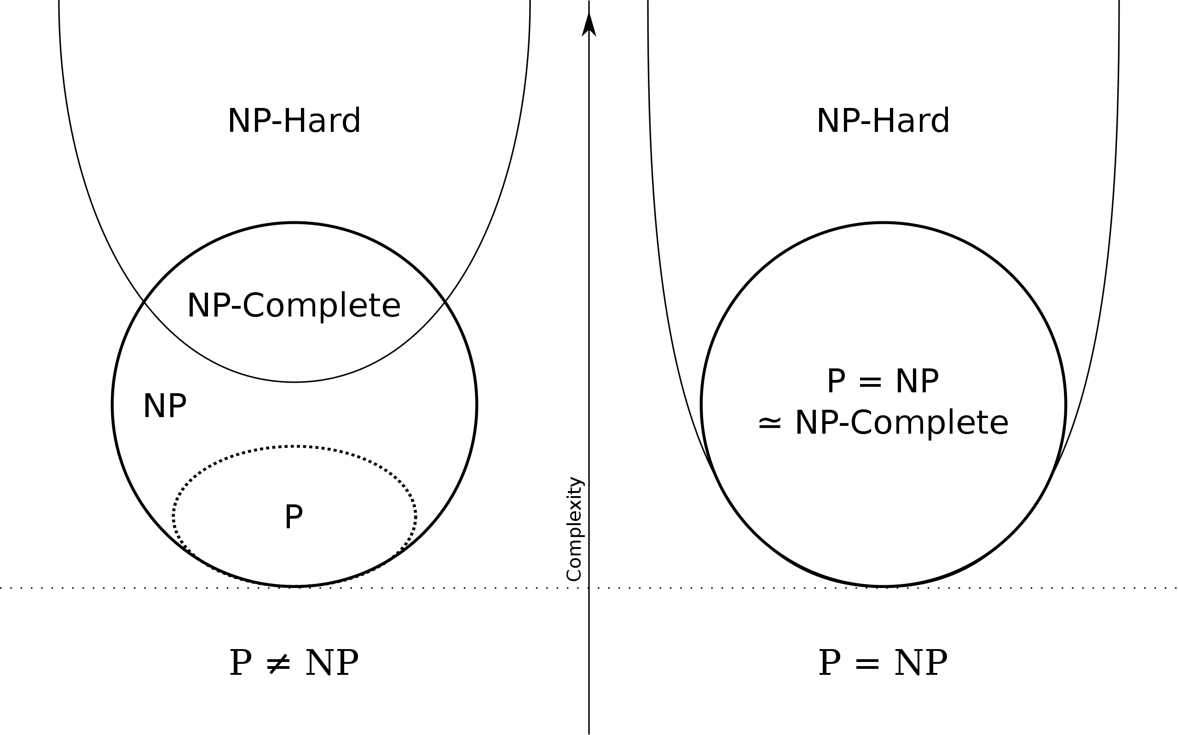
Euler diagram for P, NP, NP-complete, and NP-hard set of problems. The left side is valid under the assumption that P≠NP, while the right side is valid under the assumption that P=NP (except that the empty language and its complement are never NP-complete)

Slide 81
NP-hard but not NP-complete
--halting problem
"given a program and its input, will it run forever?"
all problems in NP are decidable in a finite number of operations, but the halting problem, in general, is undecidable.

Slide 82
THE END

